Slide 1


Slide 2
Group Members
Muneer Majeed Siraj Ali Muhammad Jamal Himayat Ali Abdul Aziz
Muhammad Sameer

Slide 3
Virtual Memory and Paging

Slide 4
Overview Of Virtual Memory

Slide 5
Virtual Memory
A computer can address more memory (Ram)then the amount physically installed on the system .
It is section of hard disk
Its appears to be present but actually it is not
It provide illusion of a large memory
Virtual memory technique allows users to use more memory for a program than the real memory of a computer

Slide 6
Ram
Hard Disk
P1
P2
p4
P3
p4
P3
P3
P3
Virtual Memory

Slide 7
Check your computer Virtual Memory
Right click on your pc
Advance System Settings
Advance
First Settings
Advance

Slide 8
Detailed Explanation

Slide 9
How Virtual Memory Works
Address Space:
Definition: The range of memory address that a process can use. It consists of virtual addresses that are mapped to physical addresses by the operating system.
User and Kernel Space: Typically divided into user space (for user applications) and kernel space (for the operating system).

Slide 10
Memory management Unit (MMU)
Role: A hardware component responsible for translating virtual address to physical addresses.
Functionality: Performs the translation quickly and efficiently, enabling processes to use virtual addresses.

Slide 11
Translation Lookaside Buffer (TLB):
Purpose: A specialized cache used to improve the speed of virtual address translation.
Mechanism: Stores recent translations of virtual addresses, reducing the time needed for address translation by avoiding repetitive lookups in the page table.

Slide 12
Advantages

Slide 13
Benefits of Virtual Memory
Simplified Memory Allocation:
Explanation: Virtual memory allows the operating system to allocate memory dynamically to processes as needed, without requiring contiguous physical memory.
Advantages: Reduces memory fragmentation, simplifies memory management for developers, and allows processes to grow beyond the size of physical memory.

Slide 14
Isolation and Protection:
Explanation: Each process operates within its own virtual address space, preventing it from accessing the memory of the other processes.
Advantages: Enhances system stability and security by isolating process from each other and the operating system, thus preventing accidental or malicious interface.

Slide 15
Efficient Multitasking:
Explanation: Virtual memory enables multiple processes to run concurrently by swapping inactive parts of processes to disk and freeing up physical memory for active processes.
Advantages: Improves overall system performance and responsiveness, allowing for more effective use of available resources.

Slide 16
Paging

Slide 17
Introduction to Paging
Definition of Paging:
Explanation: Paging is a memory management scheme that eliminates the need of contiguous allocation of physical memory. It brakes memory into fixed-sized blocks called pages (in virtual memory) and page frames (in physical memory).
Purpose: Allows for more efficient and flexible use of memory by ensuring that any page of a process’s virtual memory can be placed in any available page frame in physical memory.

Slide 18
Pages and Page Frames:
Pages: Fixed-size blocks of virtual memory, typically 4kb in size.
Page Frames: Fixed-size blocks of physical memory, of the same size as pages.
Relationship: Virtual memory pages are mapped to physical memory page frames.

Slide 19
Paging Mechanism

Slide 20
Paging Mechanism
Page Faults and Handling:
Page Fault: Occurs when a program tries to access a page that is not currently in physical memory.
Handling Process:
Detection: The MMU detects a page fault.
Interrupt: The MMU sends an interrupt to the operating system.
OS Action: The OS finds the page on disk, loads it into a free page frame in physical memory, and updates the page table.
Resume: The program resumes execution with the required page now in physical memory.

Slide 21
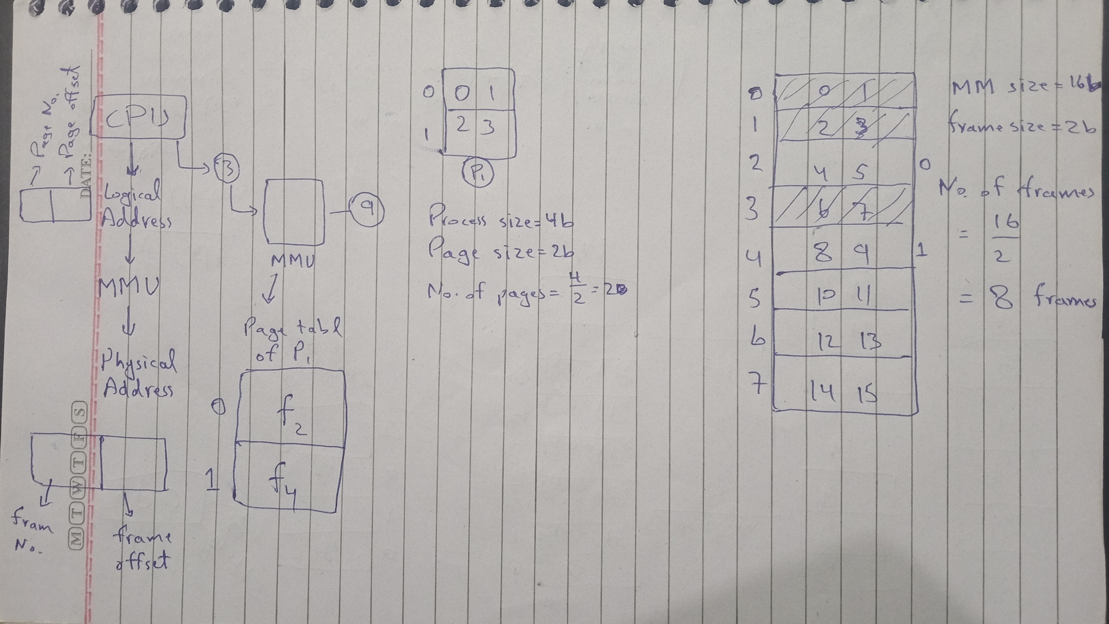
Paging Mechanism
Page Faults and Handling:
Page Fault: Occurs when a program tries to access a page that is not currently in physical memory.
Handling Process:
Detection: The MMU detects a page fault.
Interrupt: The MMU sends an interrupt to the operating system.
OS Action: The OS finds the page on disk, loads it into a free page frame in physical memory, and updates the page table.
Resume: The program resumes execution with the required page now in physical memory.

Slide 22
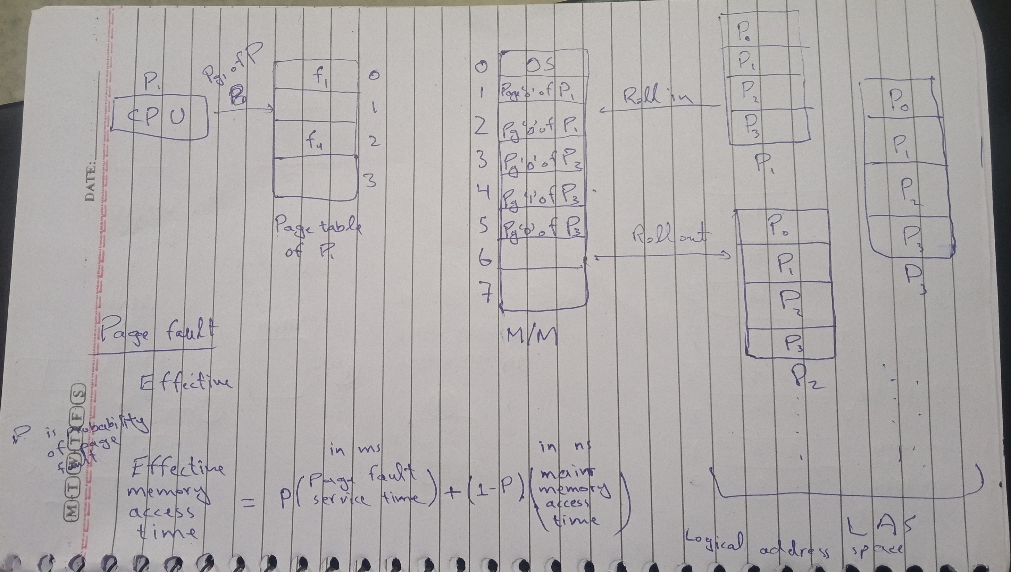
Paging Mechanism
Page Faults and Handling:
Page Fault: Occurs when a program tries to access a page that is not currently in physical memory.
Handling Process:
Detection: The MMU detects a page fault.
Interrupt: The MMU sends an interrupt to the operating system.
OS Action: The OS finds the page on disk, loads it into a free page frame in physical memory, and updates the page table.
Resume: The program resumes execution with the required page now in physical memory.

Slide 23
Page Replacement Algorithms

Slide 24
Page Replacement Algorithms:
Need for Replacement: When physical memory is full, the OS must replace an existing page with a new one.
Common Algorithms:
FIFO (First-In, First-Out): Replaces the oldest page in memory.
LRU (Least Recently Used): Replaces the page that has not been used for the longest period.
Optimal: Replaces the page that will not be used for the longest time in the future (theoretical, not implementable in practice).

Slide 25
Overview of Algorithms
FIFO (First-In, First-Out):
Explanation: Replaces the oldest page in memory, i.e., the page that has been in memory the longest.
Pros: Simple to implement.
Cons: As the oldest page may still be in frequent use.

Slide 26
LRU (Least Recently Used):
Explanation: Replaces the page that has not been used for the longest period of time.
Pros: More effective than FIFO, as it is based on actual usage patterns.
Cons: More complex to implement and requires additional data structures to track usage.

Slide 27
Optimal Page Replacement:
Explanation: Replaces the page that will not be used for the longest time in the future.
Pros: Provides the best possible performance by minimizing page faults.
Cons: Impractical to implement, as it requires future knowledge of page accesses.

Slide 28
The End

